Slide 1
Mini Project:-4
Time Series

Slide 2
Problem Statement:-To forecast PPI(producer price index).
Dataset:-
It contains 169 records.
The time component is given as quarterly.

Slide 3
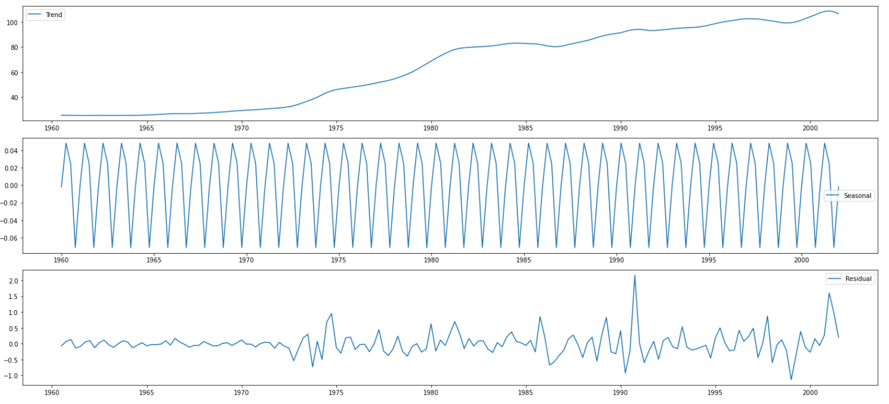
A positive trend and seasonality can be seen.

Slide 4
Treatment:-
1-Splitting into train and test with ratio 70:30.
2-Checking for data stationarity:-
Data was not stationary, p-value = 0.864
3-Data differencing method was used to make it stationary.
Data was stationary, p-value = 0.0011
4-Finding the range of p and q using PACF and ACF.

Slide 5
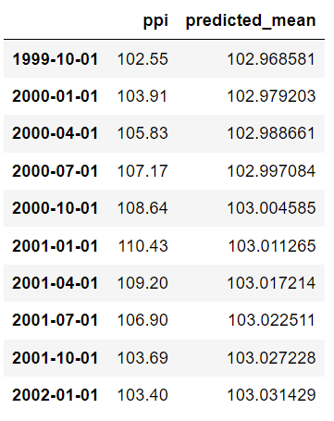
Arima model:-
The optimum value of p and q was taken using hyper parameter tunning.
p = 2
d = 1
q = 0
RMSE=3.988

Slide 6
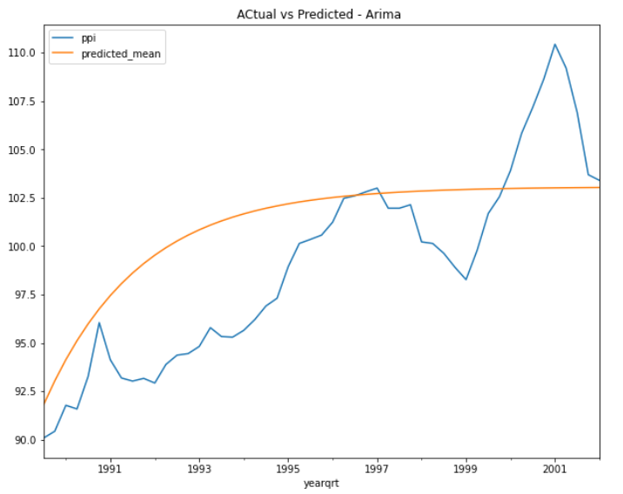
Actual vs Forecast –Arima model

Slide 7
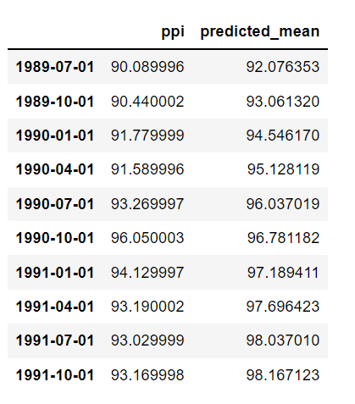
Sarima Model:-
Data was stationary for the seasonal component.
p = 2 , q = 0 ,d = 1
P = 15 , Q = 6,D = 0
RMSE = 2.8475

Slide 8
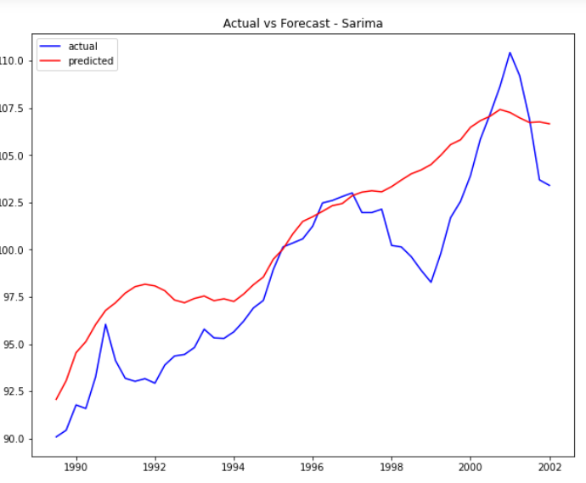
Actual vs Forecast – Sarima model

Slide 9
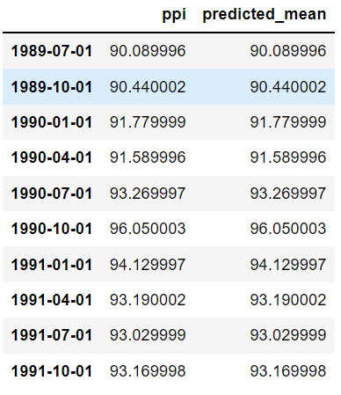
Sarimax Model:-
1- Splitting in to train and test with multiple features
cpi, gdp, m3, ppi
p = 2 , q = 0 ,d = 1
P = 15 , Q = 6,D = 0
RMSE = 0

Slide 10
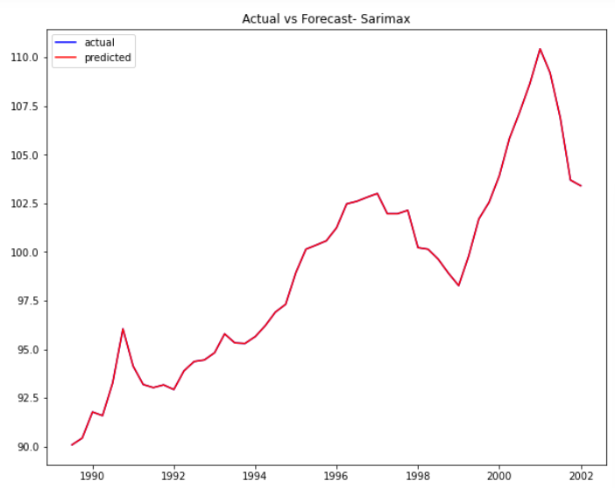
Actual vs Forecast – Sarimax model

Slide 11
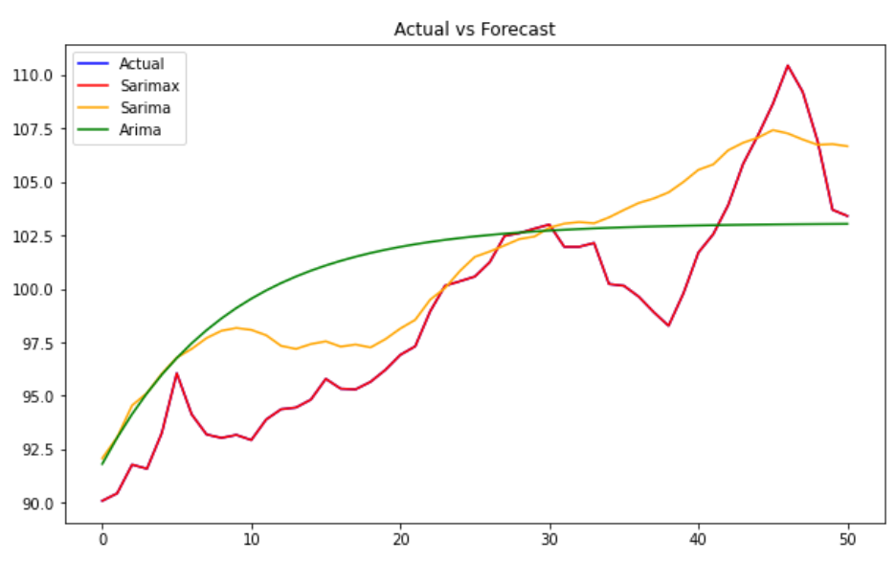
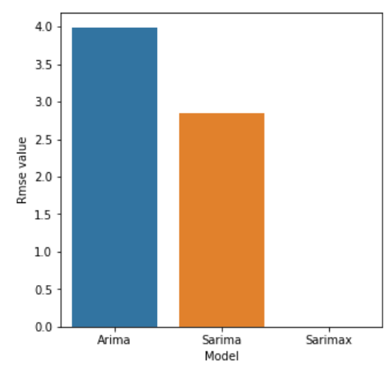
Model Evaluation:-
On the basis of the RMSE ,sarima is the
best model.The error is less compared to
arima.

Slide 12
Thank you

